Slide 1
Chapter 9
System Design

Slide 2
Introduction
System design is the phase that bridges the gap between problem domain and the existing system in a manageable way. This phase focuses on the solution domain, i.e. “how to implement?”
It is the phase where the document is converted into a format that can be implemented and decides how the system will operate.
In this phase, the complex activity of system development is divided into several smaller sub-activities, which coordinate with each other to achieve the main objective of system development.

Slide 3
Inputs to System Design
System design takes the following inputs −
Statement of work
Requirement determination plan
Current situation analysis
Proposed system requirements including a conceptual data model, modified DFDs, and Metadata (data about data).

Slide 4
Outputs for System Design
System design gives the following outputs −
Infrastructure and organizational changes for the proposed system.
A data schema, often a relational schema.
Metadata to define the tables/files and columns/data-items.
A function hierarchy diagram or web page map that graphically describes the program structure.
Actual or pseudocode for each module in the program.
A prototype for the proposed system.

Slide 5
Types of System Design
1. Logical Design:
Logical design pertains to an abstract representation of the data flow, inputs, and outputs of the system.
It describes the inputs (sources), outputs (destinations), databases (data stores), procedures (data flows) all in a format that meets the user requirements.
While preparing the logical design of a system, the system analyst specifies the user needs at level of detail that virtually determines the information flow into and out of the system and the required data sources. Data flow diagram, E-R diagram modeling are used.

Slide 6
Types of System Design
2. Physical Design:
Physical design relates to the actual input and output processes of the system. It focuses on how data is entered into a system, verified, processed, and displayed as output.
It produces the working system by defining the design specification that specifies exactly what the candidate system does. It is concerned with user interface design, process design, and data design.

Slide 7
Types of System Design
It consists of the following steps −
Specifying the input/output media, designing the database, and specifying backup procedures.
Planning system implementation.
Devising a test and implementation plan, and specifying any new hardware and software.
Updating costs, benefits, conversion dates, and system constraints.

Slide 8
Conceptual Data Modeling
It is representation of organizational data which includes all the major entities and relationship.
System analysts develop a conceptual data model for the current system that supports the scope and requirement for the proposed system.
The main aim of conceptual data modeling is to capture as much meaning of data as possible.
Most organization today use conceptual data modeling using E-R model which uses special notation to represent as much meaning about data as possible.

Slide 9
Entity Relationship Model
It is a technique used in database design that helps describe the relationship between various entities of an organization.
Terms used in E-R model:
ENTITY − It specifies distinct real world items in an application. For example: vendor, item, student, course, teachers, etc.
RELATIONSHIP − They are the meaningful dependencies between entities. For example, vendor supplies items, teacher teaches courses, then supplies and course are relationship.
ATTRIBUTES − It specifies the properties of relationships. For example, vendor code, student name.

Slide 10
The following table shows the symbols used in E-R model and their significance −
Symbol | Meaning
 | Entity
 | Weak Entity
 | Relationship
 | Identity Relationship
 | Attributes

Slide 11
 | Key Attributes
 | Multivalued
 | Composite Attribute
 | Derived Attributes

Slide 12
 | Total Participation of E2 in R
 | Cardinality Ratio 1:N for E1:E2 in R
E1
R
E2
E1
R
E2

Slide 13
Structured Design
Structured design is a data-flow based methodology that helps in identifying the input and output of the developing system.
The main objective of structured design is to minimize the complexity and increase the modularity of a program.
Structured design also helps in describing the functional aspects of the system.
In structured designing, the system specifications act as a basis for graphically representing the flow of data and sequence of processes involved in a software development with the help of DFDs.

Slide 14
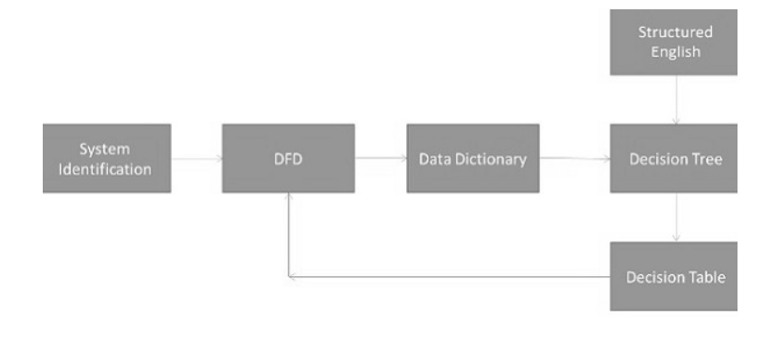
After developing the DFDs for the software system, the next step is to develop the structure chart.

Slide 15
Modularization
Structured design partitions the program into small and independent modules. These are organized in top down manner with the details shown in bottom.
Thus, structured design uses an approach called Modularization or decomposition to minimize the complexity and to manage the problem by subdividing it into smaller segments.

Slide 16
Modularization
Advantages
Critical interfaces are tested first.
It provide abstraction.
It allows multiple programmers to work simultaneously.
It allows code reuse.
It provides control and improves morale.
It makes identifying structure easier.

Slide 17
Structured Charts
Structured charts are a recommended tool for designing a modular, top down systems which define the various modules of system development and the relationship between each module. It shows the system module and their relationship between them.
It consists of diagram consisting of rectangular boxes that represent the modules, connecting arrows, or lines.
Control Module − It is a higher-level module that directs lower-level modules, called subordinate modules.
Library Module − It is a reusable module and can be invoked from more than one point in the chart.

Slide 18
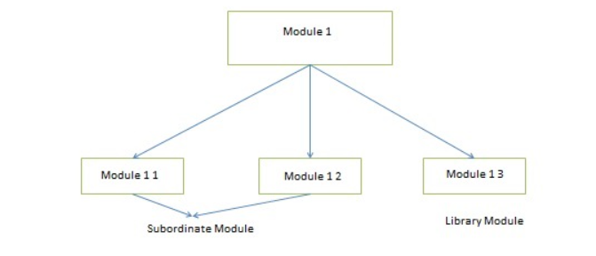
We have two different approaches to design a structured chart −
Transform-Centered Structured Charts − They are used when all the transactions follow same path.
Transaction–Centered Structured Charts − They are used when all the transactions do not follow the same path.

Slide 19
Objectives of Using Structure Flowcharts
Objectives of Using Structure Flowcharts
To encourage a top-down design.
To support the concept of modules and identify the appropriate modules.
To show the size and complexity of the system.
To identify the number of readily identifiable functions and modules within each function.
To depict whether each identifiable function is a manageable entity or should be broken down into smaller components.

Slide 20
Factors Affecting System Complexity
To develop good quality of system software, it is necessary to develop a good design.
Therefore, the main focus on while developing the design of the system is the quality of the software design.
A good quality software design is the one, which minimizes the complexity and cost expenditure in software development.
The two important concepts related to the system development that help in determining the complexity of a system are coupling and cohesion.

Slide 21
Coupling
Coupling is the measure of the independence of components. It defines the degree of dependency of each module of system development on the other.
In practice, this means the stronger the coupling between the modules in a system, the more difficult it is to implement and maintain the system.
Each module should have simple, clean interface with other modules, and that the minimum number of data elements should be shared between modules.

Slide 22
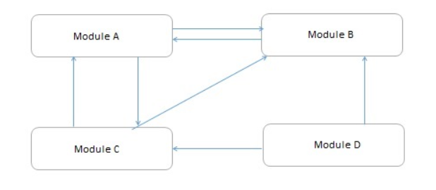
Coupling

Slide 23
Cohesion
Cohesion is the measure of closeness of the relationship between its components. It defines the amount of dependency of the components of a module on one another. In practice, this means the systems designer must ensure that −
They do not split essential processes into fragmented modules.
They do not gather together unrelated processes represented as processes on the DFD into meaningless modules.
The best modules are those that are functionally cohesive. The worst modules are those that are coincidentally cohesive.

Slide 24
Thank You

